Slide 1
Data Analysis - Segmentation
Analysis, Insights and Prediction on Customer Behavior
Evaristo Moreira – May 2024

Slide 2
Data Analysis Case Statement
Problem statement: A retail food company has a flattened customer-centric table with demographic and behavioral data. The pilot campaign to a sample of the population has been profit-negative;
Objective: Understand customer characteristics to use quantitative, segmented targeting; then build a predictive model that identifies those likely to convert to in the next marketing campaign.
Importance: Maximizing campaign profit and identifying customer segments of importance, to whom we can tailor specific strategies.

Slide 3
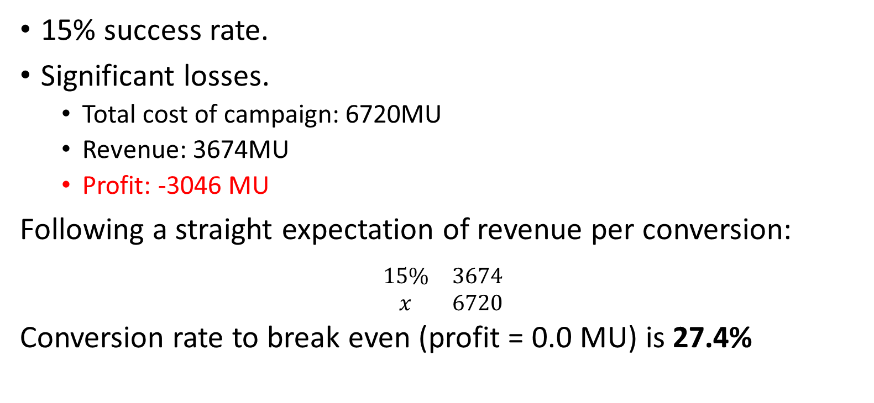
Pilot campaign
15% success rate.
Significant losses.
Total cost of campaign: 6720MU
Revenue: 3674MU
Profit: -3046 MU
Following a straight expectation of revenue per conversion:
$$\begin{matrix}15\% & 3674 \\ x & 6720\end{matrix}$$
Conversion rate to break even (profit = 0.0 MU) is 27.4%

Slide 4
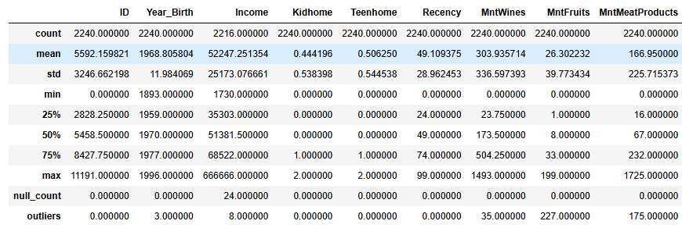
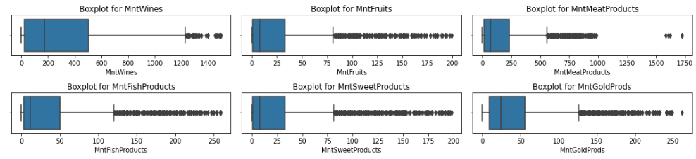
Data preprocessing
Outlier counter to detect and decide whether to remove or keep outliers and missing values.
Removed users where Year of Birth <= 1900
Removed a single row where income was ~5 x the highest income available.
Income value = “666666”
Filled users with missing income value
Filled 24 rows with mean income
Dropped columns Z_Revenue and Z_CostContact
Kept all values for amount (“Mnt”) values as there were too many outliers; meaning this is characteristic of the data (to check the boxplots).

Slide 5
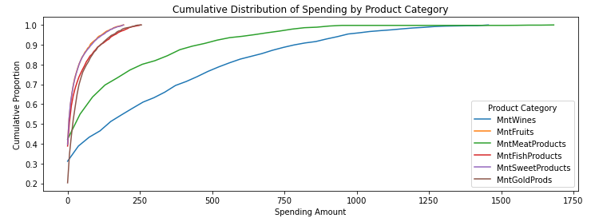





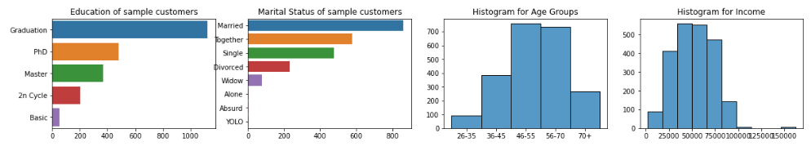


Exploratory Data Analysis
Meat and wine are categories with higher spending. (Potential targeting);
A notable proportion of customers purchase gold products, even though they are premium. (Potential cross-promotions with meat and wine to enhance perceived value);
There is a predominance in the sample of middle aged and senior citizens, most married and/or together;
No family household has more than two kids/teens;
Most clients are attended to college, very few of basic education;
We should notice that this sample should be representative enough of the full population so we can apply segmentations trained from these clients

Slide 6
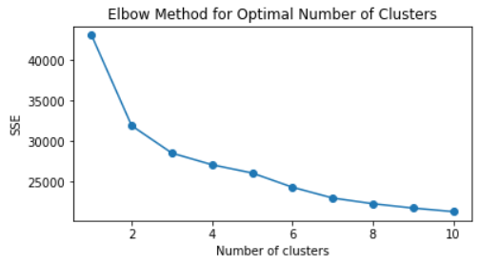
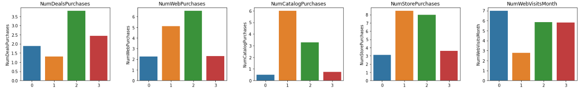
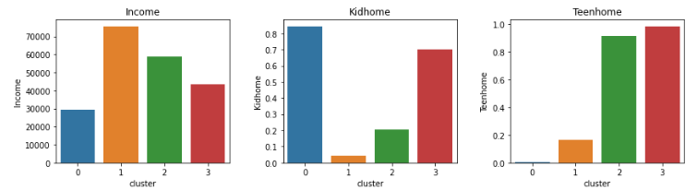
Segmentation
Method: K-Means unsupervisioned model. Using K-Means, we ran the segmentation several times to measure the distance of the points from the cluster centroid (elbow method) – this showed us that 4 clusters would be optimal for the process.
Cluster labeling:
Cluster 0: "Low-Income Families with Small Children" Characteristics: Low income, basic education, high number of small children, low spending across categories, higher web visits.
Cluster 1: "High-Income, High Spenders" Characteristics: High income, low number of children, indifferent to deals, high spending accross all categories inclusive gold products, low web visits.
Cluster 2: "Moderate-Income, Older Adults, Balanced Spending" Characteristics: Above average income, more teens at home, higher spending on wines, moderate spending on other categories, high web and deal purchases.
Cluster 3: "Middle-Income Families with Teens, Low Spenders" Characteristics: Below average income, more children (small and teens), low spending across categories, higher web visits, deal chasers.
All the other charts are redered in the jupyter notebook

Slide 7
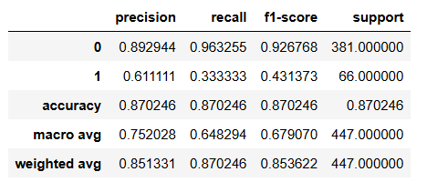

Predictive modeling
Method: Random Forest Classifier. It’s the choice as it is robust and suitable for classification problems.
Avg Precision from Cross validation: 72%
A 72% precision (capability of detecting true converters) is significantly better than the original 15% success rate.
F1-Score of 43% is not a good overall score, but the precision is good.
It is possible to try to reunite a small set of models so that together, they increase F1-Score (ensemble method).
Common scores:
Although the model can be applied as it will outperform having no model, it's recommendable to further refine the model by using ensemble methods to increase overall performance.

Slide 8


Characteristics of clients that converted
Most are single (single, divorced or widowed) clients, of higher (non basic) education. They have fewer children, spend well across all categories (including gold products) and are more likely to have accepterd offers in previous campaigns (1-5)
Users are more inclined to convert when they pertain to cluster 1 = "High-Income, High Spenders"
Cluster 1: High income, low number of children, indifferent to deals, high spending across all categories inclusive gold products, low web visits.
Users are less inclined to convert when they pertain to cluster 3 = "Middle-Income Families with Teens, Low Spenders“
Cluster 3: Below average income, more children (small and teens), low spending across categories, higher web visits, deal chasers.
Strategy: Focus on High-Converting Segments from cluster 1. To emphasize the high-quality and premium aspects of the products to attract high spenders. Also to avoiding Low-Converting Segment for the sixth campaign.

Slide 9



Thanks for making it up here!
evaristo.ssm@gmail.com
https://linkedin.com/in/evaristomoreira
https://github.com/vavasjc

